Slide 1
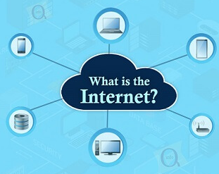
What is internet?
Internet is a global network that connects billions of computers across the world with each other and to the World Wide Web.

Slide 2
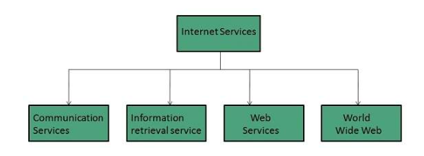
Internet Services

Slide 3
Communication Services There are various Communication Services available that offer exchange of information with individuals or groups.
Electronic Mail Used to send electronic message over the internet.
Telnet Used to log on to a remote computer that is attached to internet.
Instant Messaging Offers real time chat between individuals and group of people. Eg. Yahoo messenger, MSN messenger.

Slide 4
Information Retrieval Services There exist several Information retrieval services offering easy access to information present on the internet.
File Transfer Protocol (FTP) Enable the users to transfer files.

Slide 5
Web Services Web services allow exchange of information between applications on the web. Using web services, applications can easily interact with each other.
World Wide Web (WWW)
WWW is also known as W3. It offers a way to access documents spread over the several servers over the internet. These documents may contain texts, graphics, audio, video, hyperlinks. The hyperlinks allow the users to navigate between the documents.
Video Conferencing
Video conferencing or Video teleconferencing is a method of communicating by two-way video and audio transmission with help of telecommunication technologies.

Slide 6
Features of Internet
Accessibility
An Internet is a global service and accessible to all. Today, people located in a remote part of an island or interior of Africa can also use Internet.
Easy to Use
The software, which is used to access the Internet (web browser), is designed very simple; therefore, it can be easily learned and used. It is easy to develop.
Interaction with Other Media
Internet service has a high degree of interaction with other media. For example, News and other magazine, publishing houses have extended their business with the help of Internet services.
Low Cost
The development and maintenance cost of Internet service are comparatively low.

Slide 7
Flexibility of Communication
Communication through Internet is flexible enough. It facilitates communication through text, voice, and video too. These services can be availed at both organizational and individual levels.
Security
Internet facility has to a certain extent helped the security system both at the individual and national level with components such as CCTV camera, etc.

Slide 8
Internet Applications
Internet applications are server-based applications. Following are a few Internet Applications −
World Wide Web (WWW)
Electronic mail (e-mail)
File Transfer Protocol (FTP)
Telnet (i.e., log-in to the computer located remotely)
Internet Relay Chat (IRC) (Real time video chatting)

